Slide 1



Using Life Insurance to Pay for Long-Term Care | Client Guide
Page 1 of 4, see disclaimer on last page.

Slide 2
Using Life Insurance to Pay for Long-Term Care
If you're thinking about buying a stand-alone long-term care insurance (LTCI) policy, you might have another option. An increasing number of states are permitting the sale of long-term care hybrid products that allow you to obtain long-term care coverage with a special rider added on to your life insurance policy.
How does it work?
When it comes to long-term care, you might be able to add an acceleration rider to your life insurance policy that will allow you to tap into (accelerate) your death benefit if you need long-term care during your life. For such a rider to take effect, most insurers require a prognosis of death within 12 months, and your benefits may be limited to a percentage of the face amount in your policy.
Of course, your death benefit will be reduced by the amount of benefits you receive. If your long-term care costs are high, you may eventually deplete your death benefit (assuming your policy allows it). This would negate the original purpose of your life insurance policy--to provide financially for your family members after your death.
How do I get the funds?
The operation of long-term care riders can differ from company to company. For example, in some cases you'll be reimbursed for your long-term care expenses as they're incurred, up to the limit set by the rider. In other cases, you may receive a percentage of the death benefit each month, which you can then apply to your long-term care expenses. Before you purchase such a rider, make sure you understand exactly how you'll be reimbursed.
In addition, you'll want to know what triggers the prepayment of your death benefit that can be used for long-term care. For example, does simply needing home health care entitle you to benefits, or will you need to be chronically ill and unable to perform at least three activities of daily living to start receiving benefits?

Slide 3
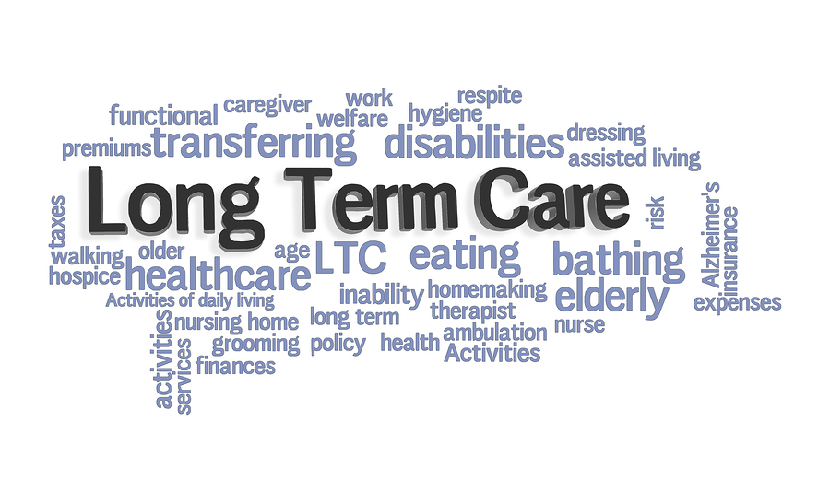
Using Life Insurance to Pay for Long-Term Care
How do I decide if I should buy a long-term care rider or a separate
long-term care insurance policy?
Opinions differ on whether an acceleration rider can be an adequate substitute for a separate LTCI policy. The answer depends in part on the size of your life insurance policy, the money you'll receive while the policy is in force to pay your long-term care costs, and how much long-term care is expected to cost at the time you'll need it.
If you do the math, you'll probably discover that an acceleration rider on your life insurance policy won't cover all of your long-term care expenses. In fact, it may give you a false sense of security that all of your needs will be met. And keep in mind that long-term care benefits you receive will reduce the policy's death benefit, possibly leaving little or nothing for your remaining family members.
However, the premiums on a stand-alone LTCI policy can be very costly, depending on your current age, your health, and the benefits offered. If these costs make such a policy prohibitive, a long-term care rider on your insurance policy may be a plausible middle-ground solution. A rider can allow you to tap into funds in the future should you need long-term care (even if that means
less for your surviving loved ones). For help in assessing your personal situation, contact an insurance professional.

Slide 4
Important Disclosures
Borden Hamman Insurance Marketing and AimcoR Group, LLC. do not provide investment, tax, or legal advice. The information presented here is not specific to any individual's personal circumstances.
To the extent that this material concerns tax matters, it is not intended or written to be used, and cannot be used, by a taxpayer for the purpose of avoiding penalties that may be imposed by law. Each taxpayer should seek independent advice from a tax professional based on his or her individual circumstances.
These materials are provided for general information and educational purposes based upon publicly available information from sources believed to be reliable—we cannot assure the accuracy or completeness of these materials. The information in these materials may change at any time and without notice.

