Slide 1

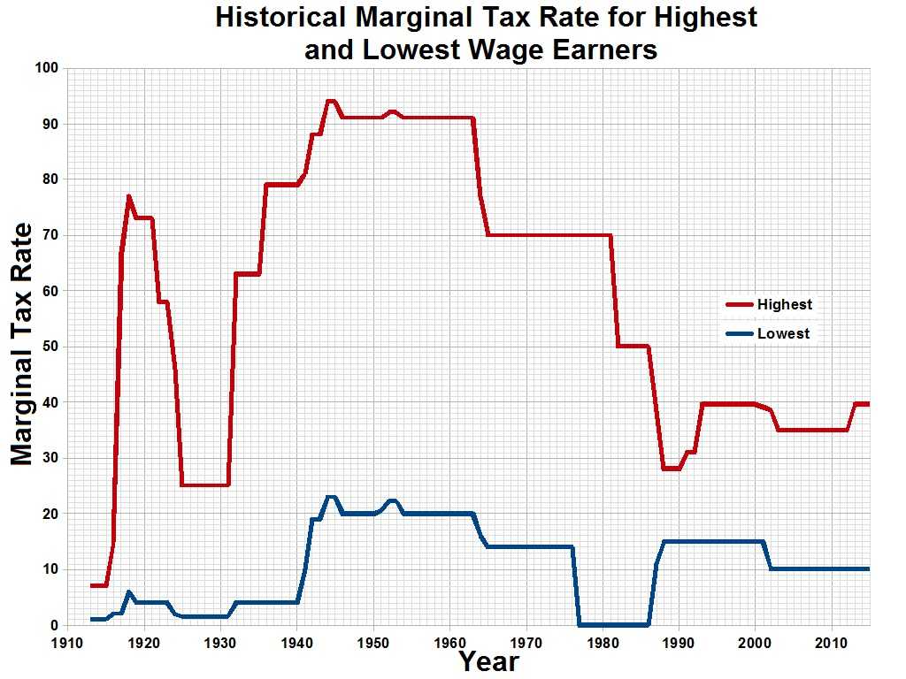
Sales Idea
Navigating The New Tax Environment Role Play / Script
CLIENT PROFILE:
Age 55 or younger.
High six figure income, above the Roth IRA contribution limit.
Look for clients in the medical, legal, sales and investment professions, small business owners, senior corporate executives and professional athletes.
Producer Opening Comments
Thanks for stopping by. As I mentioned on the phone, I’m very excited to tell you about a strategy that you’ll be very interested in.
It provides a tax-advantaged way to financially protect your family, and
May provide you with tax-free supplemental income when you retire.
Agenda: Today I would like to do three things with you. Discuss…
The Challenge (current tax environment)
The Opportunity (talk about options available to turn the challenge into opportunity)
Discuss Your Options (look at some options for your to live a tax-advantaged retirement.
THE CHALLENGE – Tax Rates
Let’s look at what’s happened to tax rates over time.
For Financial Professional Use Only | Not Approved for Use with Consumers

Slide 2
Sales Idea
Navigating The New Tax Environment Role Play / Script
KEYS TO THE SALE
These high-income earners are interested in how to lessen their tax burdens
They diversify their investment portfolios for accumulation, however, they typically do not diversify when it comes to retirement income and taxes
They have a significant need for life insurance to protect their incomes, but don’t appreciate its ability to provide tax-advantaged income.
Let’s take a look at what tax rates look like for high income earners.
Top Federal Tax Rate | 2012 | Present | % Increase
On Ordinary Income | 35% | 44.60% | 27.43%
On Capital Gains | 15% | 25% | 66.67%
On Dividends | 15% | 25% | 66.67%
* Includes 3.80% to account for Medicare Contribution Tax and 1.20% to account for Limitation on Itemized Deductions (Pease Amendment)
The increases are substantial in percentage terms.
What is the real effect of taxes from an income perspective?
INCOME $10,000 | INCOME $10,000
Tax Rate 25% | Tax Rate 50%
Take Home $7,500 | Take Home $5,000
Most people are aware of three types or buckets of tax-advantaged savings vehicles:
Bucket 1: 401(k) – Tax deductible going in, max contribution of $18,000 and may be taxed at a maximum ordinary income tax rate of 44.6% upon withdrawal.
Bucket 2: MUTUAL FUNDS / STOCK ACCOUNTS – (15-20% capital gains tax)
Bucket 3: MUNI’S / ROTH IRAS – (0%, but most of our high income earners will have very little in this bucket) Note that, for no income tax to be imposed on Roth IRA distributions, the distributions must be considered qualified distributions under IRC § 408A(d)(2)
If you could put more in the last bucket, would you?
THE CHALLENGE – Lack of Options
For Financial Professional Use Only | Not Approved for Use with Consumers

Slide 3
Sales Idea
Navigating The New Tax Environment Role Play / Script
OPPORTUNITY
There is one more place: life insurance……yes LIFE INSURANCE – but not life insurance the way you may know it. Life insurance provides a typically tax-free death benefit¹ to those who depend on you financially. There are also several tax-favorable living benefits to life insurance. That is, benefits you can take advantage of while living.
Let me show you how people like you are buying their life insurance.
$1,000,000 Death Benefit Need
IRS
Insurance Company
Assume you needed $1 million of life insurance and you wanted it to be as inexpensive as possible. Who would set the cost of the insurance? Yes, the life insurance company. This is term insurance.
The second type of life insurance is cash value life insurance. The policy has accumulation that earns interest after the expenses of the life insurance are paid. (diagonal line)
Who sets the maximum amount you can put into a cash value life insurance policy? The IRS. Why?
People like you put as much money as they can into their cash value life insurance. Why?
Don’t buy your life insurance like everybody else does. You are not like everybody else.
For Financial Professional Use Only | Not Approved for Use with Consumers

Slide 4
Sales Idea
Navigating The New Tax Environment Role Play / Script
LET ME SHOW YOU THE NUMBERS PROPOSAL
A supplemental income in retirement strategy using life insurance can deliver:
A typical income tax-free guaranteed death benefit¹
Tax-deferred cash value accumulation.
Tax-advantaged withdrawals and loans from the policy’s cash value to supplement retirement income – even prior to age 59 ½ and without penalty. Note that outstanding loans and withdrawals will reduce policy cash values and the death benefit, and may have tax consequences.
The ability to add optional riders to accelerate the death benefit in the event of chronic or terminal illness. Obtaining benefits under the terms of such a rider provides flexibility for life’s changes but it will reduce and may eliminate the net death benefit to your beneficiaries.
Let me show you how. (Review LIRP Supplemental Illustration)
Test close: - How do you feel about this?
- Are you seeing the benefits?
- Can I build one for you, based on your benefits?
OPTIONS – HERE’S HOW I SUGGEST WE PROCEED:
Determine how much tax free death benefit you want for your family.
Determine funding pattern.
Test for IRS guideline compliance.
See if you qualify.
¹ Per IRC § 101(a)
For more information or to discuss this concept in details please contact the Borden Hamman Sales Team at 800-492-9190, ext. 1
For Financial Professional Use Only | Not Approved for Use with Consumers

