Slide 1


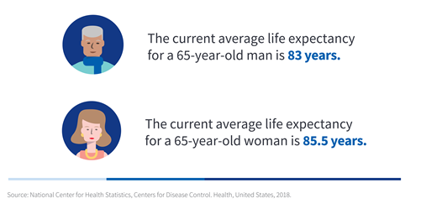

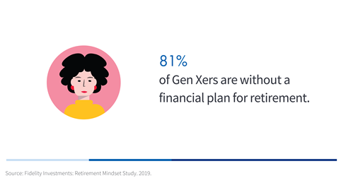

RETIREMENT PROTECTION – THUMBNAIL IMAGES
Copy and paste suggested content for use in a variety of social media outlets.
Links are embedded and optimized in the content below.
Note: Check with your compliance department before sending any messages.
Thumbnail images:
Right click to copy and then paste to accompany your post.

